Slide 1

Management

Slide 2
What is Management?
Prakhyath Rai, Asst. Professor, Department of ISE, SCEM, Mangaluru-575007

Slide 3
Few Definitions of Management
Management in all business and organizational activities is the act of getting people together to accomplish desired goals and objectives using available resources efficiently and effectively.
“Management is the art of getting things done through others.” - Mary Parker Follet.
“Management is knowing exactly what you want to do and then seeing that they do it the best and cheapest ways.” - F W Taylor.

Slide 4
“Manage is to forecast and to plan, organize, to command, to co-ordinate and to control.” - Henry Fayol.
“Management is defined as the creation and maintenance of internal environment in an enterprise where individuals, working together in groups, can perform efficiently and effectively towards the attainment of group goals.” - Koontz and O’Donnel.
“Management is a multipurpose organ that manages a business, manages a manager and manages workers and work.” – John F. Mee.
Prakhyath Rai, Asst. Professor, Department of ISE, SCEM, Mangaluru-575007

Slide 5
Nature and Characteristics of Management
Management is Universal Process
Applied in all types of institutions – social, religious, political, military, commercial, bureaucratic etc.
Every organization whose aim is to achieve its goals through group efforts, needs planning, coordination, direction and control – Management
Management is a goal oriented
Management is directed towards achieving effectiveness and efficiency. { Effectiveness is nothing but the actual achievement of specific organizational goals while Efficiency is the attainment of those goals with an optimal use of resources.}
Prakhyath Rai, Asst. Professor, Department of ISE, SCEM, Mangaluru-575007

Slide 6
Management is a social process
Management basically deals with managing human beings and their emotions, talents, attitudes, culture, ethos, education etc.
Management includes retaining, developing and motivating people at work, as well as taking care of their satisfaction as social beings.
Management is a coordinating force
Orderly arrangement of activities to avoid duplication and overlapping.
Integrates human and physical resources.
Prakhyath Rai, Asst. Professor, Department of ISE, SCEM, Mangaluru-575007

Slide 7
Management is intangible
Management cannot be touched and felt.
It does not have physical presence (It is an unseen force).
Management is multi-disciplinary
Management has received rich contribution from various disciplines like psychology, sociology, anthropology etc.
Management is about creating synergy (Synergy means “the whole is greater than the sum of its parts”).
Management is dynamic
Management is an on going process, it continues to operate as long as there is organized action for the achievement of group goals.
Prakhyath Rai, Asst. Professor, Department of ISE, SCEM, Mangaluru-575007

Slide 8
Management is a creative activity
Management provides creative ideas and new imagination
Management is decision making
Management of an organization continuously takes decisions which decides the fate of the organization.
Management is a profession
Individuals can be trained and turned to become a management professional.
Prakhyath Rai, Asst. Professor, Department of ISE, SCEM, Mangaluru-575007

Slide 9
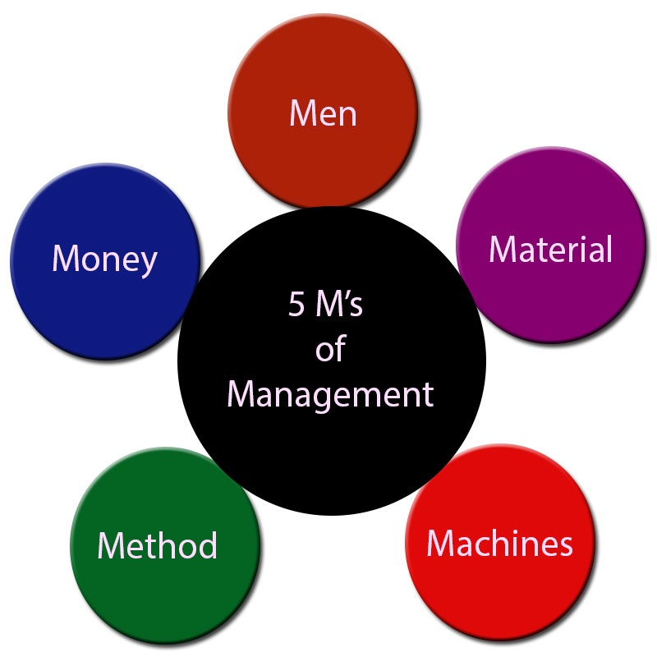
Scope of Management
Management as an Economic Resource
Five M’s of Management
Money
Man
Material
Machinery
Methods
Management as a class or Elite
Managers constitutes a class of professional who are elite all over the world
A manager is a person who has people working under him, and that could be in any part of the activity
Prakhyath Rai, Asst. Professor, Department of ISE, SCEM, Mangaluru-575007

Slide 10
Scope of Management in Various areas of work (or) Functional areas of management
Production / Operations Management
Operations Management includes work analysis, planning, scheduling, routing, quality control, inventory control and work study.
Financial Management
It includes economic forecasting, cost accounting, budgeting, insurance and financial statistics.
Personnel Management or HR Development
Personnel management takes care of recruitment, placement, training, transfer, promotion, safety, health, welfare, services etc., of the employees.
Prakhyath Rai, Asst. Professor, Department of ISE, SCEM, Mangaluru-575007

Slide 11
Marketing Management
It is the process of getting the right product to the right place in the right quantity at the right price and at the right time.
Maintenance Management
Maintenance refers to actions carried out to replace, repair or service all the components in a manufacturing plant so that it continues to operate at a required level for a specified time.
Direction and organization of resources in order to keep the buildings, equipment's and other service facilities in the working condition.
Prakhyath Rai, Asst. Professor, Department of ISE, SCEM, Mangaluru-575007

Slide 12
Materials Management and purchasing
3 Inputs to organizations – Men, Machines and Materials
Material Management – Planning, directing, controlling and coordinating all activities which are i/p to manufacturing process.
Purchasing and Procurement – 5 R’s {of the Right Quality, in the Right Quantity, from the Right Source, at the Right Prices, and at the Right Time}
Transport Management
Transportation of raw materials as well as finished goods
Includes studies on – transportation by rail, road, air and water, packing and warehousing etc.,
Actions to reduce transportation costs.
Prakhyath Rai, Asst. Professor, Department of ISE, SCEM, Mangaluru-575007

Slide 13
Systems Management
Modular decomposition of projects, delegate duties, track status periodically, communicate with clients, integrate modules, test the s/w and responsible for meeting the deadline for project completion.
Rural Management
Rural resources and issues management{such as Water resource management, forest and forest product management, crop management, cattle management, rural man power management}.
Office Management
Organized documentation of all activities
Planning and controlling all office work including maintaining and keeping records.
Clerks, Cashier, Accountants and Office Managers.
Prakhyath Rai, Asst. Professor, Department of ISE, SCEM, Mangaluru-575007

Slide 14
Functions of Management
Planning
Planning of all activities to achieve production & sales as per targets.
Planning is necessary to avoid difficulties that may arise in future.
Organizing
Organizing in arranging money, material, machinery, men and selecting optimal methods of actual execution of work.
Prakhyath Rai, Asst. Professor, Department of ISE, SCEM, Mangaluru-575007

Slide 15
Staffing
Staffing involves recruitment, selection, training and development of personnel required to run the organization.
Controlling
Controlling the work of employees to ensure everything is proceeding as per plan.
Prakhyath Rai, Asst. Professor, Department of ISE, SCEM, Mangaluru-575007

Slide 16

Management as a Science, Art and Profession
Management as a Science:
Establishment of management principles scientifically.
Management is Social Science – As it deals with humans.
Management provides guidelines rather than absolute principles as in physics, chemistry and biology.
Scientific inquiry and observation
Experimentation
Management as a Art:
Use of Knowledge
Creativity
Personal touch
Constant Practice
Prakhyath Rai, Asst. Professor, Department of ISE, SCEM, Mangaluru-575007

Slide 17
Management as a Profession:
Management is also considered as a profession – one can study, acquire skills and qualify to become manager.
Like any profession, management has a systematic body of principles, techniques, and skills.
Difference between Science and Art
Science | Art
1. Defines | Describes
2. Proves | Feels
3. Predicts | Guesses
4. Objective | Subjective
5. Measures | Opines
6. Impresses | Expresses
7. Advances by knowledge | Advances by practice
Prakhyath Rai, Asst. Professor, Department of ISE, SCEM, Mangaluru-575007

Slide 18
Characteristics of Profession Vs Management
Well-defined body of knowledge
Profession have a systematic body of principles, techniques and skill.
Management also has a systematic body of principles, techniques and skill.
Formal Education and Training
Individual can enter a profession only after acquiring specific knowledge and skill through formal education and training.
To enter into management also, an individual has to acquire appropriate knowledge and training.
Prakhyath Rai, Asst. Professor, Department of ISE, SCEM, Mangaluru-575007

Slide 19
Representative Body
Profession have regulatory bodies and strict code of conduct.
Managers don’t have a universal code of conduct and they also don’t have common regulatory body to ensure standard practices.
Service Motto
A professional has to have service as his motto and must safeguard the society from any risks.
Managers may not have such motto.
Management conforms to most of the characteristics of a profession, and hence can be called as profession.
Prakhyath Rai, Asst. Professor, Department of ISE, SCEM, Mangaluru-575007

Slide 20
Management and Administration
Three Views:
Administration is broader than Management
Management is broader than Administration
Management and administration are Identical
Prakhyath Rai, Asst. Professor, Department of ISE, SCEM, Mangaluru-575007

Slide 21
Difference Between Administration and Management
Administration | Management
1. Determining Objectives | Planning the work to meet the objectives given by administration
2. Framing policies and principles | Executes the policies and programs
3. Framework under which one has to work | Supervises and control execution of work
4. Direction, guidance and leadership and brings in resources | Coordinates all the resources and activities
5. Comes first and Provides guidelines to the management and organization | Comes Second and derives strength and freedom from administration to plan and execute work
Prakhyath Rai, Asst. Professor, Department of ISE, SCEM, Mangaluru-575007

Slide 22
Role of Managers
Interpersonal Roles
Figure Head - Representing an organization
Leader - Encouraging and Motivating Employees
Liaison - Connecting outside world, develops external links
Informational Roles
Monitor – Receives information from various sources on matters concerning organization
Disseminators - Transmitting information within the organization
Spokesman - Transmitting information outside the organization
Prakhyath Rai, Asst. Professor, Department of ISE, SCEM, Mangaluru-575007

Slide 23

Decision Roles
Entrepreneur - Encouraging New Ideas
Disturbance handler - Conflict handler
Resource allocator
Negotiator - Managers has to negotiate in important matters concerning the organization
Prakhyath Rai, Asst. Professor, Department of ISE, SCEM, Mangaluru-575007

Slide 24
Levels of Management
First line[Lowest] or Supervisory Management
Made-up of white collar supervisor
Middle line
Example: Sales Manager, Plant Manager, Personnel Manager, Department Heads
Top Management
Consist of Board Chairman, Executives, MD’s, Secretary
Prakhyath Rai, Asst. Professor, Department of ISE, SCEM, Mangaluru-575007

Slide 25
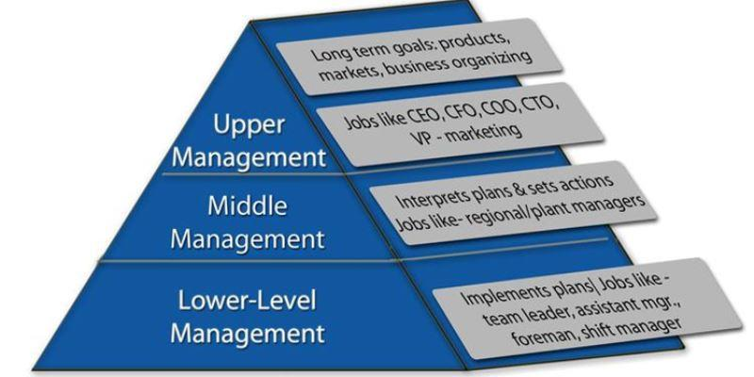
Levels of Management
Prakhyath Rai, Asst. Professor, Department of ISE, SCEM, Mangaluru-575007

